Slide 1
“Cavitak- Data Analyst Assignment”
GitHub Link for Dashboard:-https://github.com/hemantg111/Cavitak_Assignment_Power-BI.git
By
Hemant Gupta
LinkedIn- https://www.linkedin.com/in/hemant-gupta-4914baa6

Slide 2
Sales Analytics Dashboard – Key Insights
1. Top 5 Products by Revenue
Printer generated the highest revenue (₹20.55M), followed by Laptop (₹18.86M) and Webcam (₹18.29M).
Indicates strong demand for office-related electronic products like printers and laptops.
Suggestion: Increase inventory and marketing for high-demand products.
2. Top 5 Customers by Revenue
The top 5 customers contributed ₹26.50M in total revenue.
Customer_53 is the top buyer with ₹6.09M in purchases.
Suggestion: Maintain strong relationships with high-value customers through loyalty programs or exclusive offers.
3. Profit Analysis – Product Wise
Printer has the highest total profit (₹2.32M), followed by Monitor (₹1.93M) and Smartphone (₹1.82M).
Products like Speakers and Laptops also yield good profitability.
Suggestion: Focus on these products for upselling and bundle offers.

Slide 3
4. Category-wise Sales Distribution
Accessories dominate with the highest market share with 51.65% of total sales.
Computers account for 32.44% market share, followed by Mobile (8.4%) and Networking (7.5%) market share in terms of revenue.
Suggestion: Explore opportunities to boost sales in Mobile and Networking categories.
5. Monthly Sales Trend
Peak sales months: August (₹24.22M) and January (₹24.19M) .
Lowest sales month: March (₹17.04M).
Suggestion: Analyze seasonal patterns and plan marketing campaigns to boost sales in low-performing months.
6. City & Product Name Filters
Dashboard includes slicers for City and Product Name to enable location-wise and product-specific insights.
Enables management to identify high-performing regions and target improvement areas.

Slide 4
Overall Summary
The company’s revenue is driven by high-value electronic products (Printers, Laptops).
Profitability aligns closely with product demand, showing healthy margins.
Computers and Accessories lead in sales contribution, while seasonal fluctuations suggest strategic marketing opportunities.

Slide 5
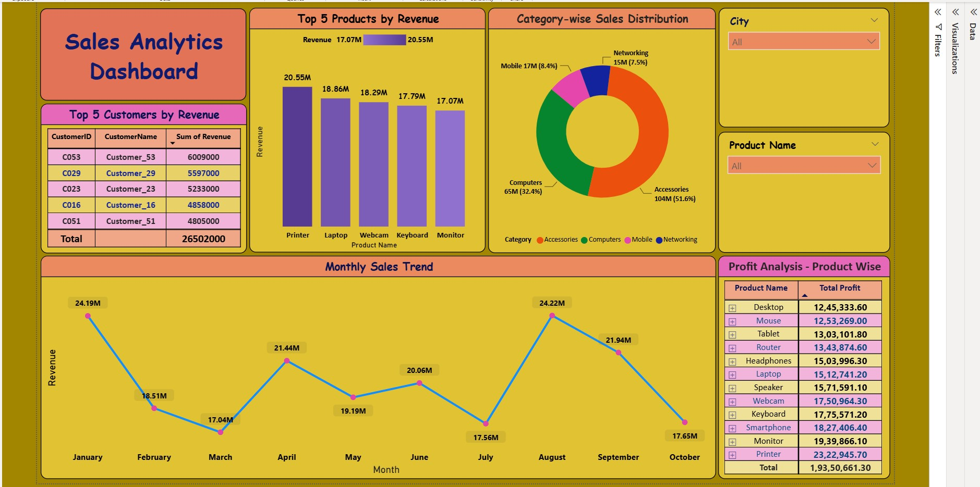
Power BI Dashboard

Slide 6
Thank You

